Slide 1

Financial Analysis Using PowerBi
Presented By:
Pakkela Divya Prasanna Bharathi

Slide 2
A Comprehensive Overview
This presentation provides a comprehensive overview of our financial Analysis Dashboard, which helps to improve the decision-making process and improve Analysis part. We will explore key metrics, borrower insights, and risk analysis to equip you to make the best decision. It ensuring better financial planning and risk management. Financial Statements, Ratios, Accounting Software are the crucial tools for the proper Analysis of a company.

Slide 3
Data Preprocessing Steps:
Loading Data: Import from sources like Excel, SQL Server, or CSV using Get Data.
Data Cleaning:
Remove duplicates.
Handle missing values (replace or remove).
Trim spaces, standardize text, and correct errors.
Data Transformation:
Rename columns/tables and change data types.
Split/merge columns and reshape data with pivot/unpivot.
Data Filtering: Include/exclude rows or columns based on conditions.
Data Enrichment:
Add calculated columns.
Combine datasets using joins or append.
Grouping & Aggregation: Summarize data using sums, averages, or counts.
Remove Unnecessary Data: Delete irrelevant rows/columns for efficiency.

Slide 4
DAX Measures and Calculations:
1. Current year units:
Current_Year Units = SUM(financials[Units Sold])
. It calculates the Current Year units from the units Sold column in the financial table
2.Profit for Top Discount:
Profit for Top Discount =
CALCULATE(
financials[Profit Margin],
financials[Country] = "Top"
)
It calculates the Profit For top Discount by using the Profit Margin column and the condition
Mentioned Was “Top” from the financial Data set.
3.Profit Margin:
Profit Margin =
DIVIDE(financials[Total Gross Sales], financials[profit percentage], 0) * 100
It calculates the profit Margin by Using the Function Called Divide from the columns
like Total Gross Sales and Profit Percentage with Financial Data Table.

Slide 5
4. Sales Classification:
Sales Classification =
SWITCH(
TRUE(),
'financials'[Total Gross Sales] > 10000, "High",
'financials'[Total Gross Sales] > 5000, "Medium",
"Low" )
This measure is used to explain about Sales Classification According to conditions Mentioned
was Total Gross sales >10000 is High and >5000 is Medium and other wise considered as low.
5.Total Gross Sales:
Total Gross Sales = SUM(financials[Gross Sales])
This Measure Calculates the total Gross sales by the column Gross Sales from the Financials
Table.
6. Date Table:
The Construction of Date Table Requires a columns and Data with Proper Type and for the
Creation of the table we require a Proper Code to Represent the Date Table the code is given
Below:
Date Table = ADD COLUMNS(

Slide 6
CALENDARAUTO(),
"Year", YEAR([Date]),
"Quarter", "Q" & FORMAT(CEILING(MONTH([Date])/3, 1), "#"),
"Quarter No", CEILING(MONTH([Date])/3, 1),
"Month No", MONTH([Date]),
"Month Name", FORMAT([Date], "MMMM"),
"Month Short Name", FORMAT([Date], "MMM"),
"Month Short Name Plus Year", FORMAT([Date], "MMM,yy"),
"DateSort", FORMAT([Date], "yyyyMMdd"),
"Day Name", FORMAT([Date], "dddd"),
"Details", FORMAT([Date], "dd-MMM-yyyy"),
"Day Number", DAY ( [Date] )
)
This DAX code creates a DateTable with various date-related columns in Power BI. It uses CALENDARAUTO() to generate a date range based on the minimum and maximum dates in the data model. Each ADDCOLUMNS function adds useful date-related attributes.

Slide 7
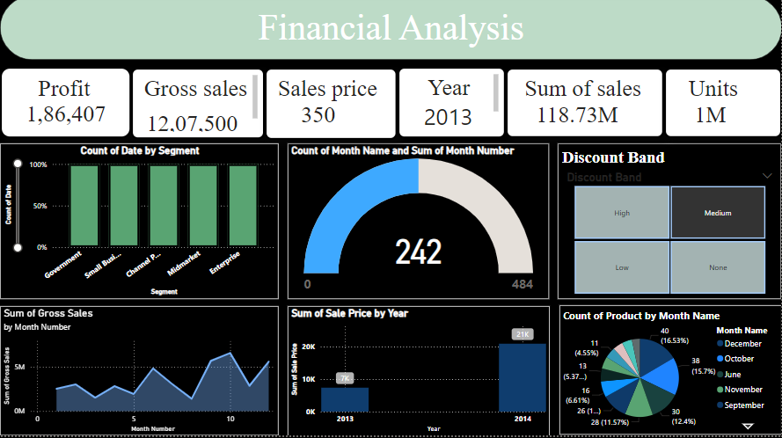
Report - 1: Financial Analysis.

Slide 8
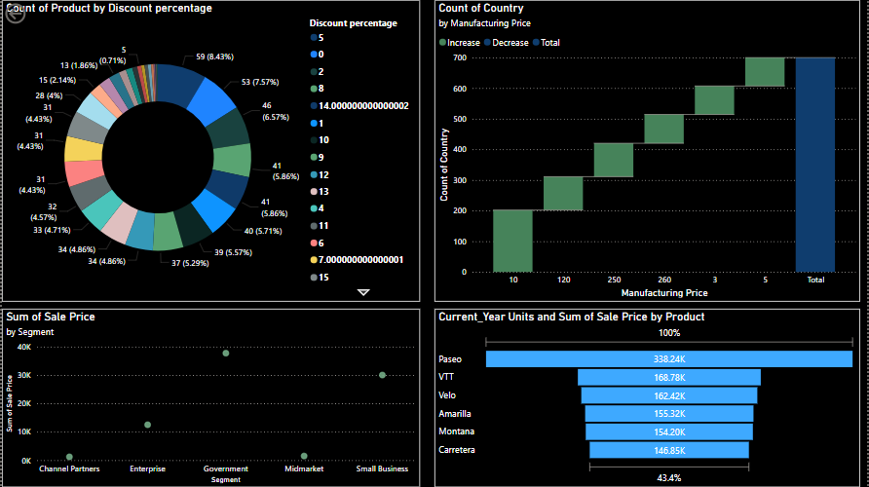
Report - 2: Brief Analysis

Slide 9
Conclusion:
Financial analysis provides critical insights into the performance, profitability, and efficiency of a business. By examining metrics such as sales, profit, discounts, and trends over time, organizations can identify strengths, address weaknesses, and optimize strategies. It aids in informed decision-making, enhances resource allocation, and drives growth. A well-executed financial analysis ensures businesses stay competitive, adapt to market changes, and achieve their financial goals effectively.

Slide 10
THANK YOU

